Slide 1



X
Banking Data Warehouse & ETL
ID/X Partners - Data Engineer
Presented by
Siti Khamilatun Nazila

Slide 2





Siti Khamilatun Nazila
Data Engineer Enthusiast
Fresh graduate Telecommunication Engineering with passion in data engineering, ETL processes, and database management. Experienced in building data warehouse solutions and optimizing data pipelines.
Skills:
Database: SQL Server, MySQL/MariaDB, ETL Processes
Tools: Talend, SSMS, Excel, PowerPoint, Word
Languages: SQL, Python, Java, HTML, CSS, Javascript
Others: Data Modeling, Data Warehousing , Documentation
Gresik, Jawa Timur
khamilatunnazila22@gmail.com
linkedin.com/in/sitikhamilatunnazila

Slide 3
Courses and Certification
• Cloud Computing | Digitalent KOMDIGI | 2025
• Intermediate Junior Web Developer | Digitalent KOMDIGI | 2025
• Fundamental Junior Web Developer | Digitalent KOMDIGI | 2025
• Konsep Pemrograman | Digitalent KOMDIGI | 2025
• AI Development | Digitalent KOMDIGI | 2025
• Alibaba Cloud Studio & Gwend | Alibaba Cloud | 2025
• IoT Fundamentals | Huawei | 2024
• Network Security | Huawei | 2024
• Data Science (AI/ML) - Talent Scouting Academy | Digitalent KOMDIGI | 2024
• Junior Network Administrator | BNSP | 2024
• Access Network Planning | BNSP | 2024
• Junior Network Administrator | Digitalent | 2024
View certificates here!

Slide 4

About Company
ID/X Partners (PT IDX Consulting) is a technology consulting company based in Jakarta, Indonesia, specializing in data analytics, decision systems, and Regulatory Technology (RegTech). The company provides innovative solutions that help organizations, particularly in the financial sector, such as banks, fintechs, and insurance companies, make data-driven decisions and improve operational efficiency.
With a team of over 200 professionals and more than 75 clients across various industries, ID/X Partners offers expertise in data analytics, business intelligence, decision engines, and big data solutions. The company is recognized for its strong focus on leveraging data and advanced technology to optimize business processes and support digital transformation.

Slide 5
Project Portfolio
Banking Data Warehouse & ETL Solution
Background:
Client in banking industry faced challenges consolidating data from multiple sources (Excel, CSV, SQL Database) causing delayed reporting and analysis.
Problem Statement:
Data scattered across 8 different sources
Manual data consolidation processes
Inefficient reporting system
Lack of centralized data repository
Available Data Sources:
transaction_excel.xlsx
transaction_csv.csv
Database Sample
Project explanation video here!

Slide 6
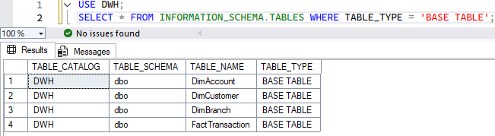
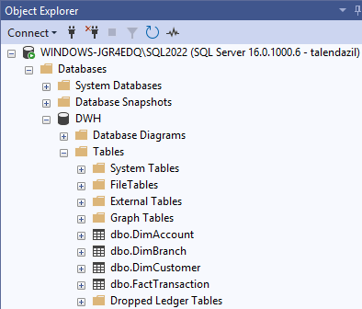
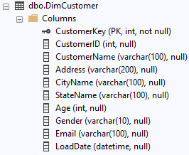
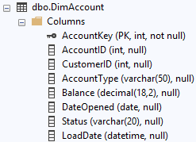
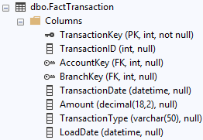
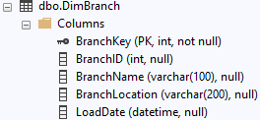
Data Warehouse Creation
Strategy:
Designed star schema data warehouse
Created 3 dimension tables + 1 fact table
Implemented proper PK-FK relationships
Optimized for query performance
Results:
Database 'DWH' created successfully
DimAccount, DimCustomer, DimBranch tables
FactTransaction table with proper relationships
All tables populated with sample data

Slide 7
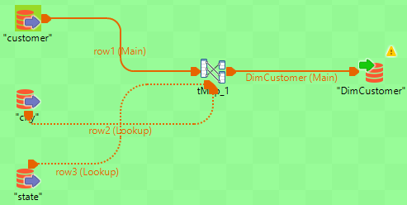
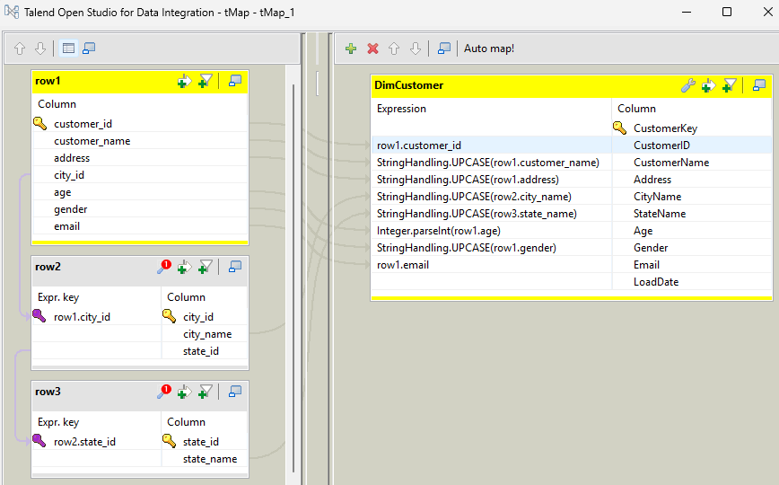
Create ETL Job for Dimension Table
Strategy:
Used Talend Open Studio for ETL processes
Implemented tMap for data transformation
Applied uppercase conversion for text fields (except ID, Age, Email)
Joined multiple tables for DimCustomer
Results:
CustomerName, Address, CityName, StateName → UPPERCASE
PascalCase column naming convention
Data integration from customer, city, state tables

Slide 8
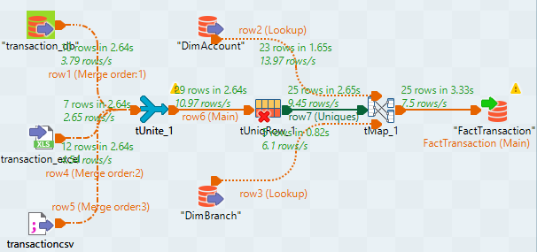
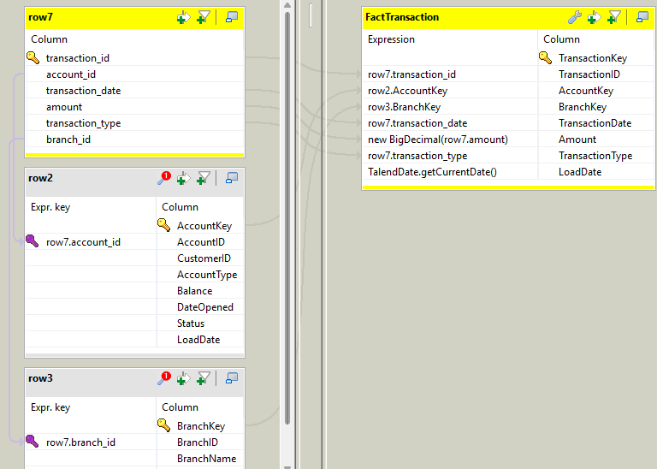
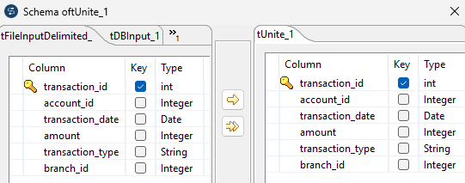
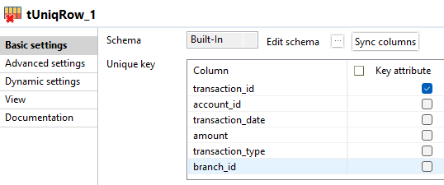
Create ETL Job for Fact Table
Strategy:
Consolidated data from 3 sources (Excel, CSV, Database)
Used tUnite to combine data streams
Implemented tUniqRow to remove duplicates
Mapped to dimension keys using tMap
Data Quality Assurance:
No duplicate TransactionID
Valid AccountID and BranchID references
Complete data integrity maintained

Slide 9
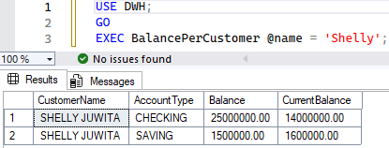
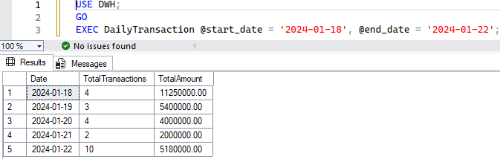
Create Stored Procedure
DailyTransaction SP:
Parameters: @start_date, @end_date
Output: Daily transaction summary
Use case: Management reporting
BalancePerCustomer SP:
Parameter: @customer_name
Output: Customer balance tracking
Use case: Customer service & analysis

Slide 10
Technical Achievements
Successfully integrated 8 data sources
Implemented automated ETL processes
Built optimized data warehouse structure
Developed parameterized stored procedures
Ensured data quality and no duplicates
CHALLENGES & SOLUTIONS
Challenge 1: Data Format Consistency
Solution: Standardized data formats in tMap
Challenge 2: Duplicate Data Handling
Solution: Implemented tUniqRow with proper key fields
Challenge 3: Complex Balance Calculations
Solution: Used CASE WHEN with SUM aggregation in SP
Business Impact
Reporting time reduced from hours to seconds
Single source of truth for transaction data
Improved decision-making capabilities
Scalable solution for future growth
Key Learnings:
Data integration best practices
ETL job optimization techniques
Data warehouse design principles

Slide 11
Thank You
X

